Slide 1

Power BI : DAX
Dr.Pasidth Thanachotanankul

Slide 2
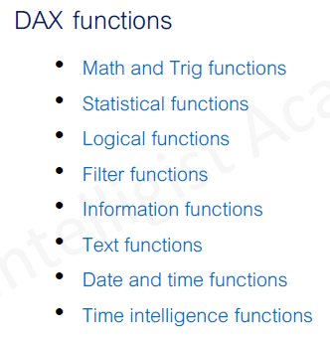
DAX = Data Analysis Expressions

Slide 3
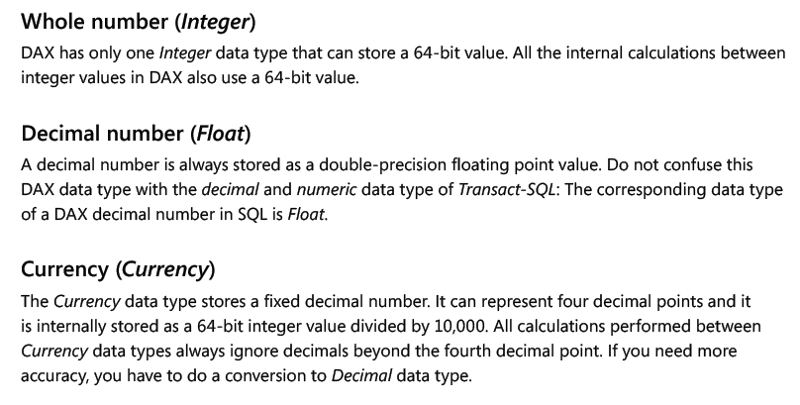
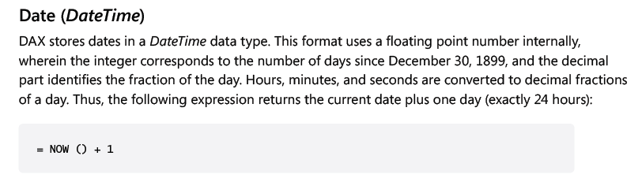
Data Types used in DAX Formulas

Slide 4
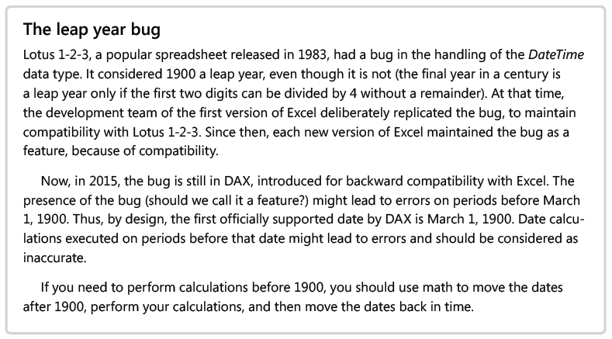

Slide 5
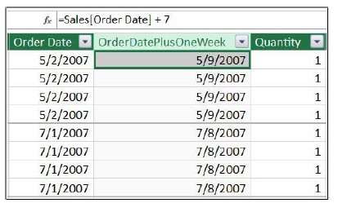
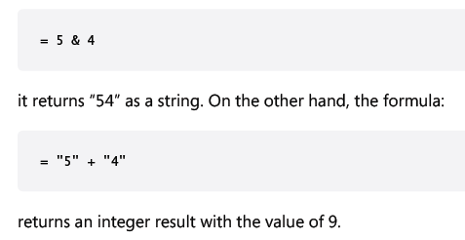


Slide 6
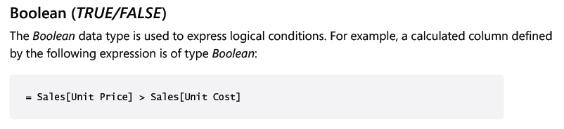
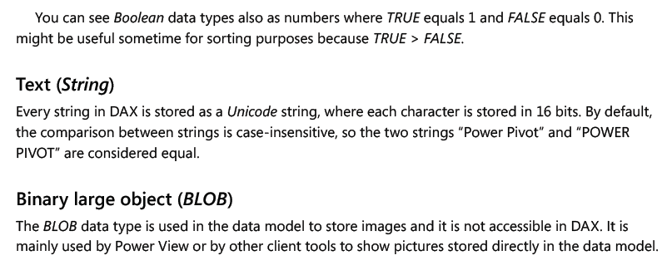

Slide 7
Basic DAX Syntax
A DAX formula is comprised of an equal sign followed by a function or expression.
Functions perform operations such as concatenating or adding values, calculating sums or averages, or performing logical tests.
An expression can be used to define a value that can be a literal value or constant, a Boolean test, or a reference to a column containing values.
Operators within expressions, such as a plus or minus sign, indicate how the values are to be compared or processed.
Values that you use in formulas and expressions can be typed directly into the formula bar as part of an expression, or they can be obtained from other columns, tables, or formulas

Slide 8
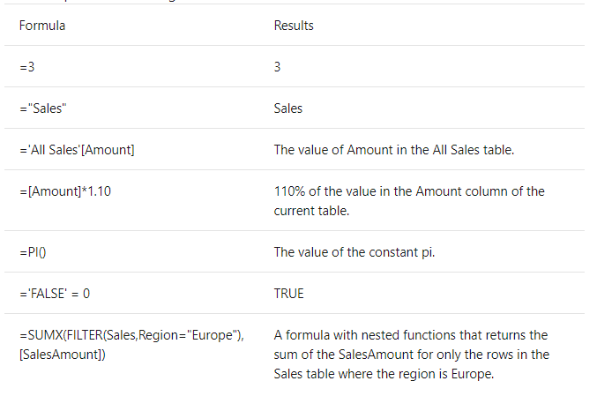

Slide 9
Table-Valued Functions
Filter functions Return a column, table, or values related to the current row.
Aggregation functions Aggregate any expression over the rows of a table.
Time intelligence functions Return a table of dates, or use a table of dates to calculate an aggregation.

Slide 10
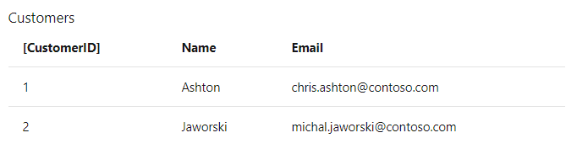
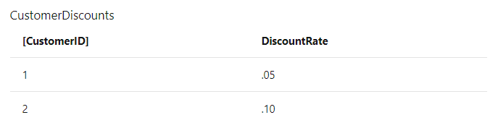
Formulas and the Relational Model
Within this model, tables are connected to each other by relationships, which let you create correlations with columns in other tables and create more interesting calculations.
One to One

Slide 11
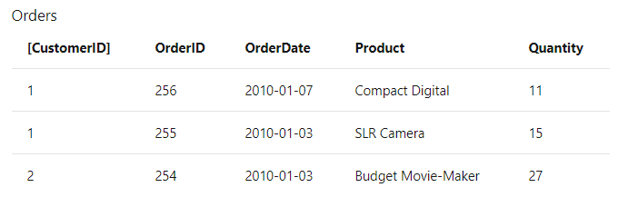
One to Many

Slide 12
Columns and Keys
Relationships are based on columns in each table that contain the same data. For example, the Customers and Orders tables can be related to each other because they both contain a column that stores a customer ID.
Primary key: uniquely identifies a row in a table, such as CustomerID in the Customers table.
Alternate key (or candidate key): a column other than the primary key that is unique. For example, an Employees table might store an employee ID and a social security number, both of which are unique.
Foreign key: a column that refers to a unique column in another table, such as CustomerID in the Orders table, which refers to CustomerID in the Customers table.
Composite key: a key that is composed of more than one column. Composite keys are not supported in PowerPivot for Excel. For more information, see "Composite Keys and Lookup Columns" in this topic.

Slide 13
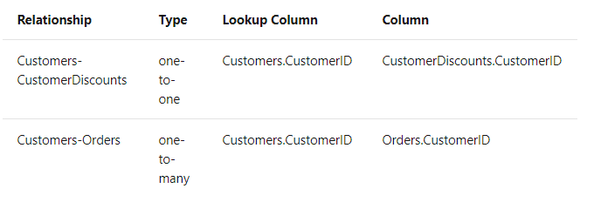
Types of Relationships
https://docs.microsoft.com/en-us/previous-versions//ee835534(v=technet.10)

Slide 14
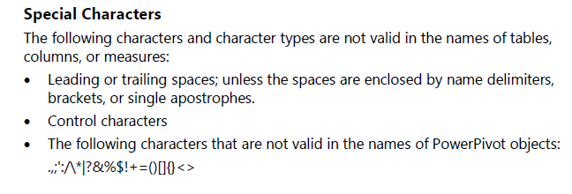

Slide 15
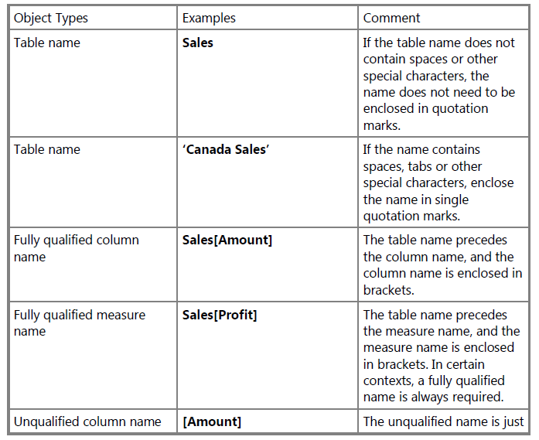
Object Name

Slide 16
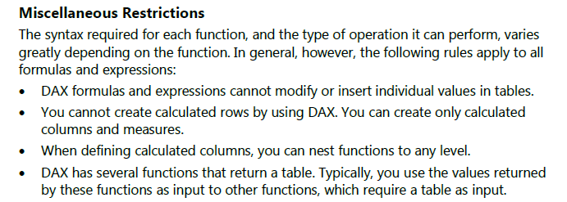

Slide 17
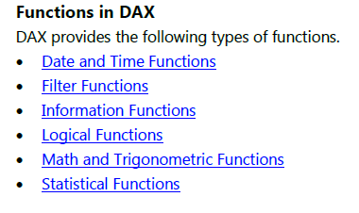


Slide 18
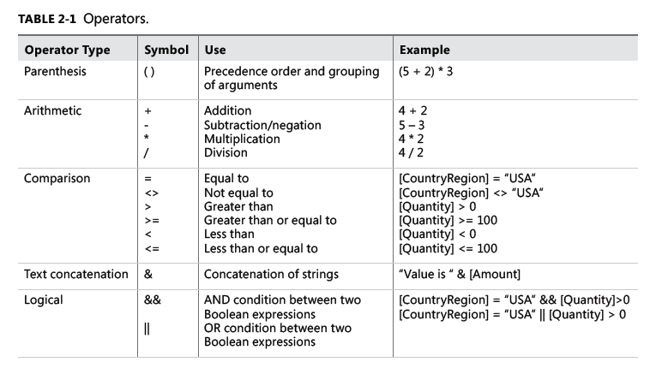

Slide 19
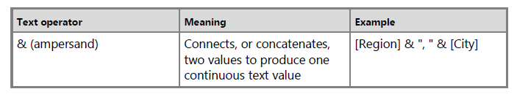
Text Concatenation Operator

Slide 20
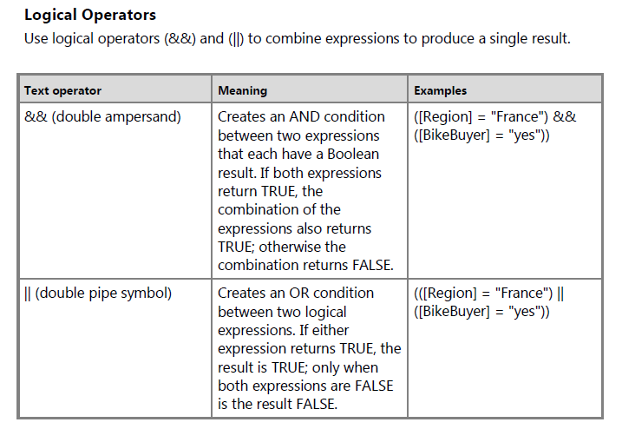

Slide 21
Measures and Calculated Columns
Calculated Columns
you create a DAX formula that defines the column values.
=EOMONTH([StartDate],0])
→ calculates the end of the month value for each row
if the value in the StartDate column is 6/1/2001, the value in the calculated column will be 6/30/2001.
Measures
Measures can be based on standard aggregation functions, such as COUNT or SUM, or you can define your own formula by using DAX
When you define a formula for a measure, nothing happens until you drop the measure into a PivotTable.

Slide 22
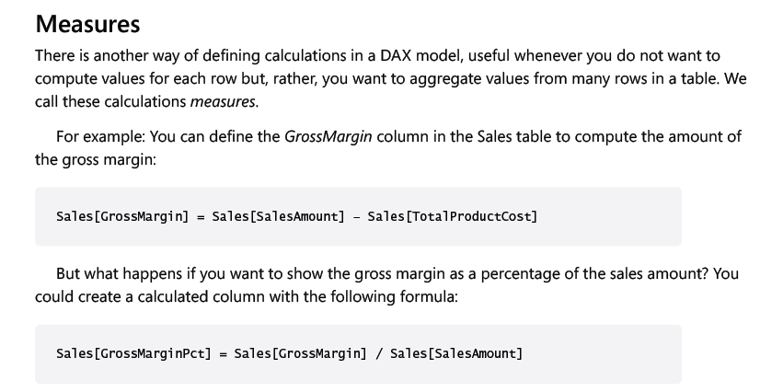

Slide 23
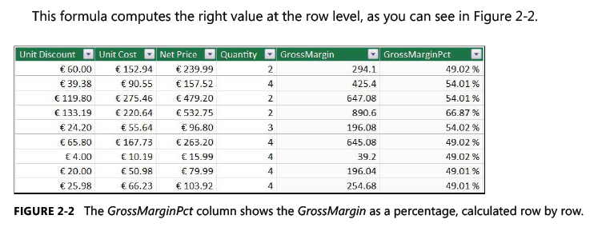

Slide 24
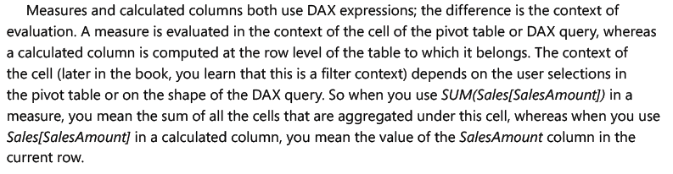

Slide 25
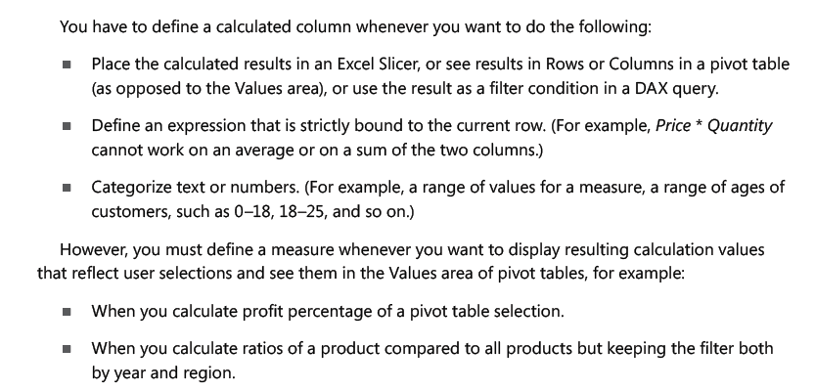

Slide 26
Workshop: file oeeRaw.xls

Slide 27
Load Data into Power BI
Create new columns
PerA = (Sheet1[NetOperateTime]/480)
PerP = Sheet1[Standard CT]/(Sheet1[NetOperateTime]/Sheet1[Qty])
PerQ = 1-Sheet1[Defect]/Sheet1[Qty]
OEE = Sheet1[PerA]*Sheet1[PerP]*Sheet1[PerQ]
Create Graph
Line Graph -> PerA,PerP,PerQ,OEE
Donut Graph -> McNo
Gauga Graph -> OEE

Slide 28
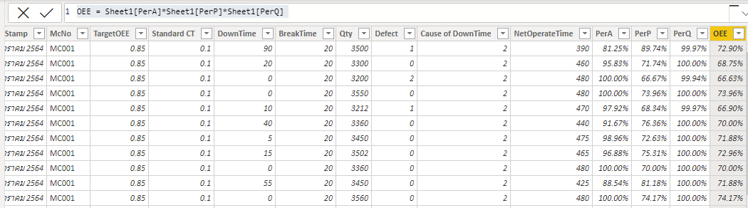

Slide 29
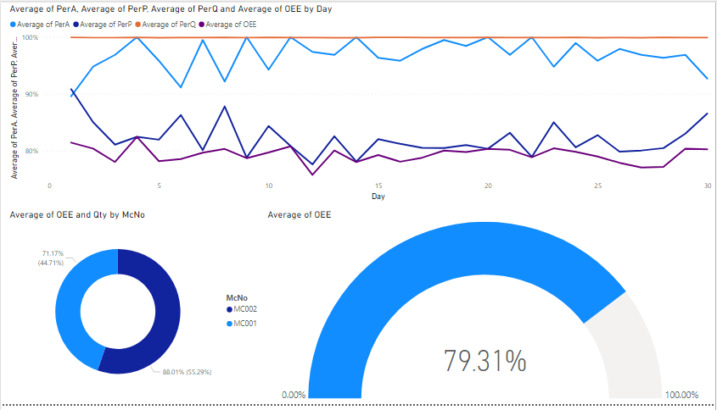

Slide 30
1- Calculate()
It is one of the most important functions that help you evaluate the expressions by adding your own filters to data.
Syntax- CALCULATE(<expression>, <filter1>, <filter2>…)
Example-
Sum of sales all countries = CALCULATE(SUM(‘Sales'[Sales]),ALL(‘SalesGeography’))
The column that you want to aggregate is represented by the first parameter, whereas the 2nd filter represents a boolean that removes all the filters. This specific function is mostly used with aggregation functions. Moreover, this powerful function acts as a supercharged “IF” statement and provides real insight into your data.

Slide 31
#2- Filter()
The working of the Filter function is the same as the Calculate function. The major difference between the two is that Filter functions are not mutable and are commonly used to return a subset of expression or table.
Syntax- FILTER(<table>,<filter>)
Example-
Count of sales orders over 200 = COUNTROWS(FILTER(‘Sales’, ‘Sales'[Sales] > 200))
The identification of the expression resulting in a table is represented by the first parameter, whereas the 2nd parameter represents a true/false or boolean expression assessed from each row of the table. If you are thinking of using it as a standalone function, then you might not be able to get the result because this function is used with other functions.

Slide 32
#3- ALL function()
All function is another useful DAX function of Power BI that you should know about. It is basically used to get all the rows and columns in a table irrespective of the applied filters. If you want to calculate the aggregations, then All functions will help you get an accurate value.
Syntax: ALL(<table> or <column>)
Example-
Count of grand total sales= COUNTROWS(ALL(‘Sales’))
In this example, ALL functions are applied to the sales table by clearing all the filters that you might have applied earlier. This function plays a great role, especially if you want to calculate denominators for calculating ratios and percentages. Similar to the Filter function, ALL function is used in conjunction and allows you to get a count of grand total sales.

Slide 33
#4- Related()
Related is categorized under table function that is applied to the conditions and operations on the entire table. With this function, you can easily return the related value from another table by using the below-mentioned syntax.
Syntax- RELATED(<column>)
Example-
Count of sales in the America = COUNTROWS(FILTER(ALL(‘Sales’), RELATED(‘SalesGeography'[Countries]) = “America”))
In this example, the count of sales for America is retrieved from one table to another by establishing a relationship. This particular expression is executed in a row context and helps you retain the relationships between columns of that table. Whenever this function is performed, all the values in the specified table are examined regardless of any filters.

Slide 34
#5- Min ()
By using the Min() function, you can get the smallest value in a column within a blink of an eye. Also, you can get the smallest value between two scalar expressions accurately. Texts, numbers, blanks, and dates are some types of values that are counted in Min function. If you use a blank, then it will be considered as zero(0).
Syntax- MIN (Column Name) or MIN (expression1, Expression2)
Example- MIN([SalesMargin])
The example added above will get you the smallest value from the added column of SalesMargin. Say, if you want to get the result of two scalar expressions, then use two values in this function like- Min([TotalSales], [ResellerMargin]). In this example, you will get the minimum values from the column TotalSales and ResellerMargin

Slide 35
6- Max()
If you want to extract the maximum value from the column or between two scalar expressions, then the Max() function can help you in the same. Basically, it is totally opposite to the Min() function. It returns the maximum value of your added expression.
Syntax– MAX(<column>) or MAX(<expression1>, <expression2>)
Example– MAX(OnlineSales[ProfitAmount])
The example added above returns the maximum value found in the ProfitAmount column of the OnlineSales. You don’t have to spend hours to get the maximum value. By applying a single function, you will receive an accurate value.
Say if you want to get the maximum value of two expressions, then use the function like- Max([TotalSales], [ResellerMargin]). This example will get you the maximum values of TotalSales and ResellerMargin. Always remember that if you use a blank value in the expression, then it will be treated at Zero(0).

Slide 36
#7- Average()
Are you spending hours on finding the average (arithmetic mean) of all the numbers in a column? If yes, then this function is for you. It allows you to get an average value of all the numbers. While adding non-numeric values like text, remember that no aggregation will be performed, and it returns blank. Also, while adding logical values or empty values, the function will not be performed because all such values are ignored, but if your cell includes zero value, then it will be counted.
Syntax- AVERAGE (Column Name)
Example- AVERAGE(OnlineSales[ProfitAmount])
The example added above will get you the average values in the column, ProfitAmount, in the table, OnlineSales. In this function, if there are no rows, then it will return a blank value. Talking about MS- Excel, then also it returns zero(0) value if the rows do not meet the conditions. So, always keep such things in mind while using DAX functions in Power BI.

Slide 37
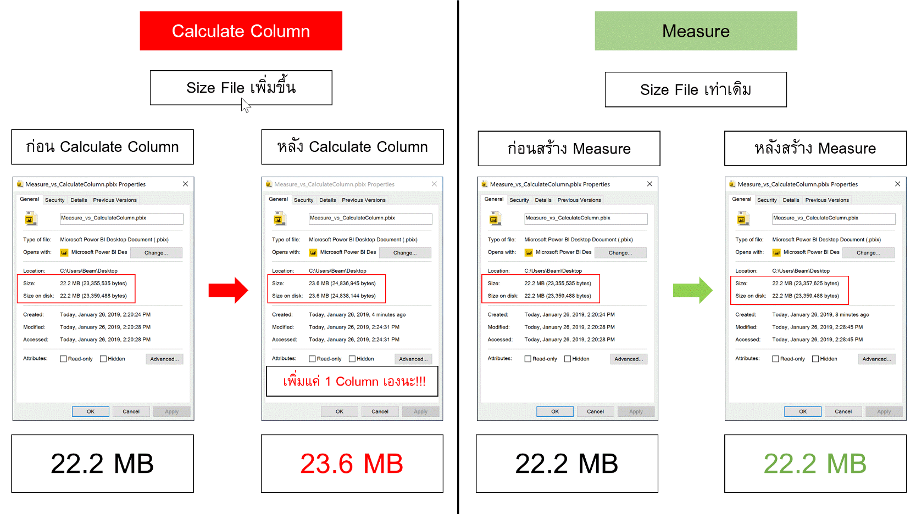

Slide 38
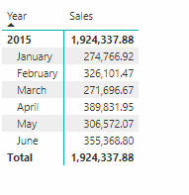
Context
Row context (sum measures by row context)
“ If you have created a calculated column, the row context consists of the values in each individual row and values in columns that are related to the current row.”
Notes:
ในทำนองเดียวกัน ถ้าเราสังเกตผลลัพธ์แต่ละบรรทัดของ Sales ก็จะเห็นว่าผลลัพธ์ออกมาต่างกัน ทั้งๆ ที่สูตรเขียนเหมือนกันแท้ๆ
เหตุการณ์นี้เกิดขึ้นได้เพราะว่าตอนคำนวณมันมี Row Context อยู่ ซึ่งเป็นตัวที่บ่งบอกว่าตัวมันกำลังคำนวณข้อมูลที่ Row ไหนอยู่ มันจึงรู้ว่า สูตร fSales[SalesQuantity] นั้นให้อ้างอิงจากข้อมูลที่อยู่ในแถวของตัวเองเท่านั้น ซึ่งการคำนวณมันจะทำซ้ำๆ ทีละแถวจนกว่าจะครบทุกแถวในตาราง (การทำซ้ำ เรียกว่า Iterate) ซึ่งเราจะเห็นพฤติกรรมนี้ในสูตรอย่าง SUMX ด้วย

Slide 39
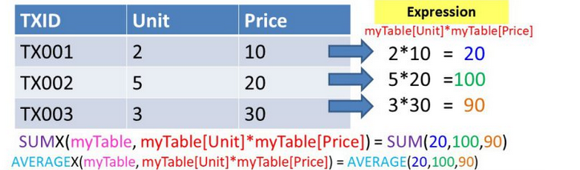
Context
Row context (sum measures by row context)
Notes:
หรือพูดอีกอย่างได้ว่า ก็คือ SUMX สามารถจำลองการคำนวณอะไรก็ได้โดยทดไว้ในหัวมัน โดยที่มันจะสร้างการคำนวณ <expression> ในแต่ละแถวของตาราง <table>* (ตรงนี้แหละคือ Row Context ที่มันรู้ว่าต้องวิ่งคำนวณ iterate ซ้ำๆ ในแต่ละแถวของ Table ไหนจนครบตาราง) จากนั้นก็เอาผลลัพธ์ในแต่ละแถวที่ทดไว้ทั้งหมดมา SUM กัน (เพราะเราใช้ SUMX)

Slide 40
Context
Filter context
“Is the set of values allowed in each column, based on filter constraints that were applied to the row or that are defined by filter expressions within the formula.”
Notes:
Filter Context (บริบทการ Filter)
ดังนั้นแปลว่า ค่าแต่ละช่องของตาราง Pivot ที่แสดงออกมา จริงๆ แล้วการคำนวณมีเงื่อนไขการ Filter ไม่เหมือนกันเลยซักช่อง
การที่แต่ละช่องอยู่ภายใต้เงื่อนไขการ Filter ที่ต่างกัน เรียกว่ามี Filter Context ที่ต่างกัน ซึ่งคำว่า Filter Context นั้นเป็น Concept ที่สำคัญสุดๆของ Power BI แล้ว

Slide 41
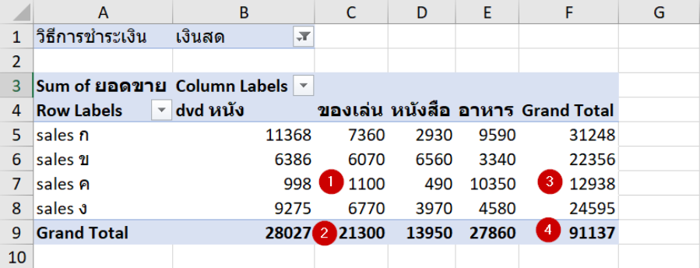
Context
Filter context
ตำแหน่งเลข 1 คือ ผู้ขาย=sales ค, สินค้า=ของเล่น, วิธีชำระเงิน=เงินสด
ตำแหน่งเลข 2 คือ สินค้า=ของเล่น, วิธีชำระเงิน=เงินสด
ตำแหน่งเลข 3 คือ ผู้ขาย=sales ค, วิธีชำระเงิน=เงินสด
ตำแหน่งเลข 4 คือ วิธีชำระเงิน=เงินสด
Notes:
Filter Context (บริบทการ Filter)
แม้วิธีสรุปจะเหมือนกัน (Measure เหมือนกัน) แต่สามารถแสดงค่าผลลัพธ์ใน Visual ต่างกัน เพราะมี Filter Context หรือวิธีการ Filter ข้อมูลก่อนที่จะคำนวณ Measure ที่ต่างกัน

Slide 42
DAX functions
Math and Trig functions
Statistical functions
Logical functions
Filter functions
Information functions
Text functions
Date and time functions
Time intelligence functions
https://docs.microsoft.com/en-us/dax/

Slide 43
Math and Trig functions
SUM ผลรวมของ(column)
ABS ค่า Absolute ของ ()
SUMX ผลรวมของตาราง()
LOG ค่า Log ของ ()
MOD

Slide 44
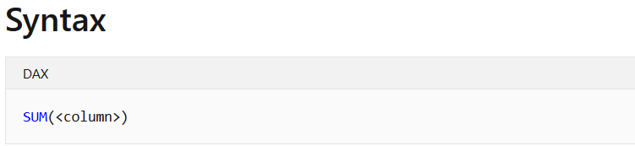
Math and Trig functions
Example
SumSales = SUM(Orders[Sales])

Slide 45
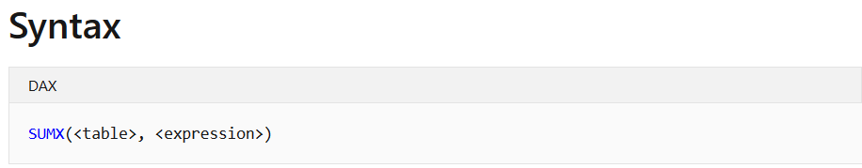
Math and Trig functions
Example
SumXQty = SUMX(Orders,Orders[Quantity]*Orders[Sales])

Slide 46
Statistical functions
COUNT
DISTINCTCOUNT
AVERAGE
MAX
MIN

Slide 47
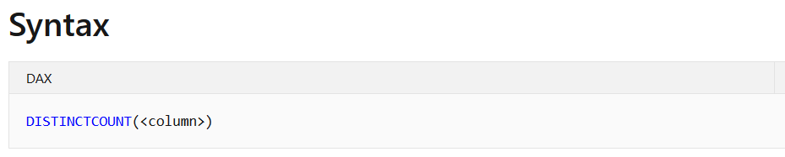
Statistical functions
Example
CountCustomer = DISTINCTCOUNT(Orders[Customer Name])

Slide 48
Logical functions
AND
OR
NOT
IF
IFERROR

Slide 49
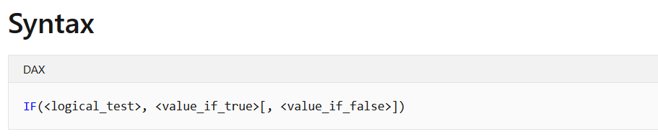
Logical functions
Example
Sales Group = IF(SUM(Orders[Sales])>10000,“Good",“Bad")
Notes:
Sales 3 Group =
IF(
SUM(Orders[Sales]) < 10000,
"Bad",
IF(
SUM(Orders[Sales]) < 30000,
"Normal",
"Good"
)
)

Slide 50
Filter functions
CALCULATE
CALCULATETABLE
FILTER
LOOKUPVALUE
REMOVEFILTERS

Slide 51
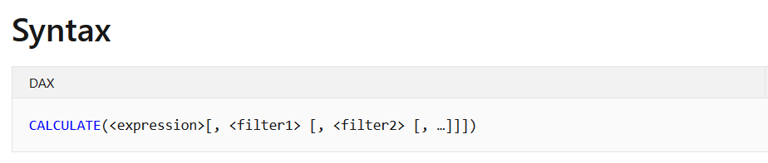
Filter functions
Example
East Revenue =
CALCULATE(
SUM(Orders[Sales]),
Orders[Region] = "East"
)
Notes:
East Revenue =
CALCULATE(
SUM(Orders[Sales]),
OR(Orders[Region] = "East",Orders[Region] = "West")
)
======================
East Revenue =
CALCULATE(
SUM(Orders[Sales]),
FILTER ( ALL ( Orders[Region]), Orders[Region] = "East" || Orders[Region] = "West" )
)

Slide 52
Information functions
ISBLANK
ISNUMBER
ISTEXT
ISNONTEXT
ISERROR

Slide 53
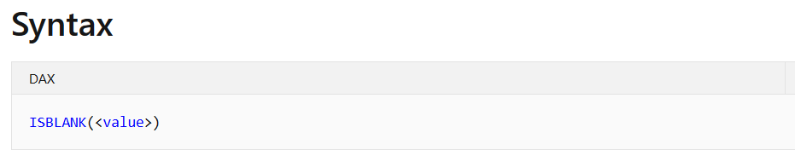
Information functions
Example
ISBLANK = ISBLANK(Orders[Sales])
Notes:
ISBLANK = ISBLANK(Orders[DateAdd-1])

Slide 54
Text functions
CONCATENTATE
REPLACE
SEARCH
UPPER
FIXED

Slide 55
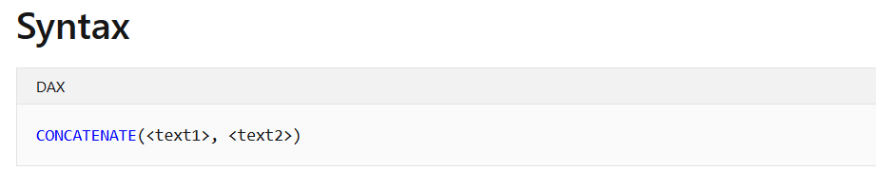
Text functions
Example
CONCAT = CONCATENATE(Orders[Name], CONCATENATE(“-”, Orders[NickName]))
Notes:
CONCAT = CONCATENATE(Orders[City], CONCATENATE("-", Orders[Region]))

Slide 56
Date and time functions
DATE
HOUR
NOW
TODAY
WEEKDAY

Slide 57
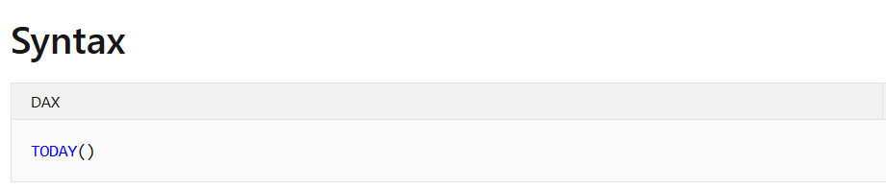
Date and time functions
Example
Todays = TODAY()
Notes:
YearDiff = YEAR(TODAY())-YEAR(Orders[Order Date])

Slide 58
Time-intelligence functions
Data Analysis Expressions (DAX) includes time intelligence functions to support the needs of Business Intelligence analysis by enabling you to manipulate data using time periods, including days, months, quarters, and years, and then build and compare calculations over those periods.

Slide 59
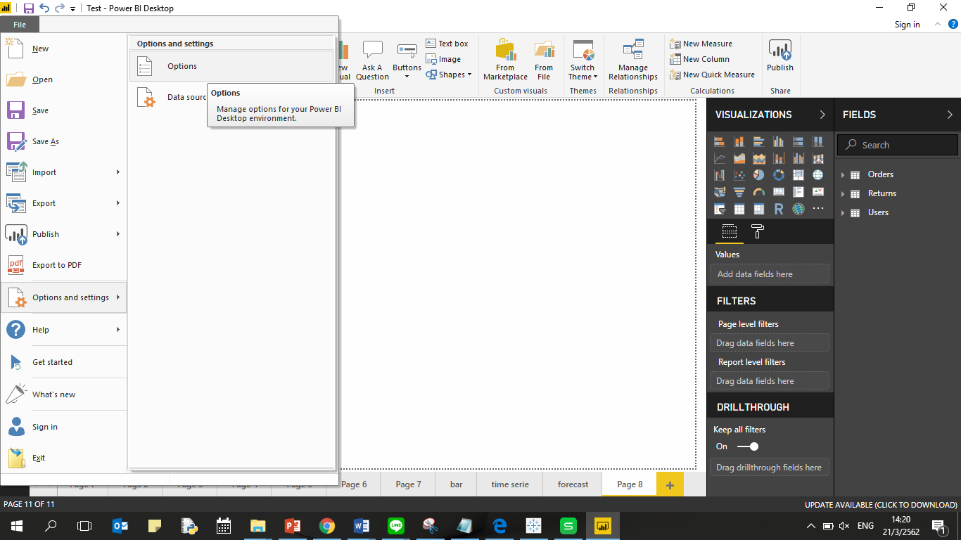
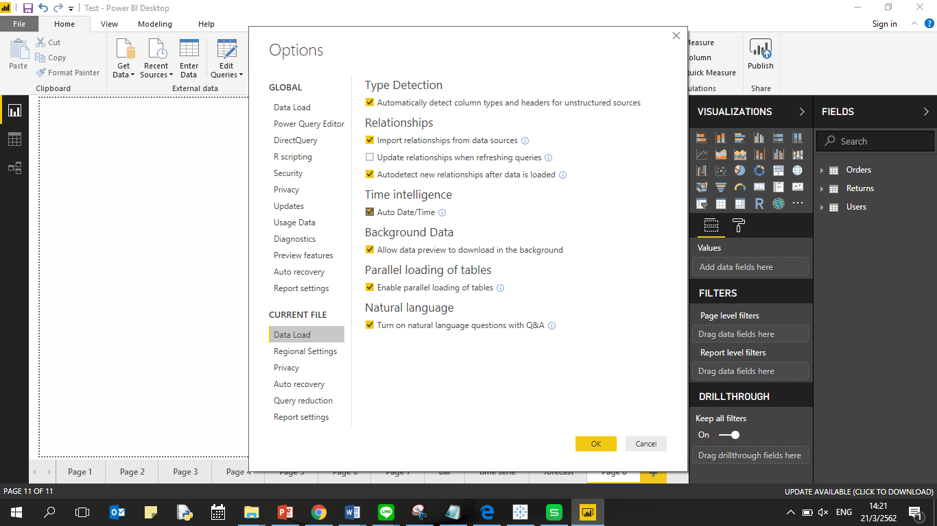
Time Intelligence

Slide 60
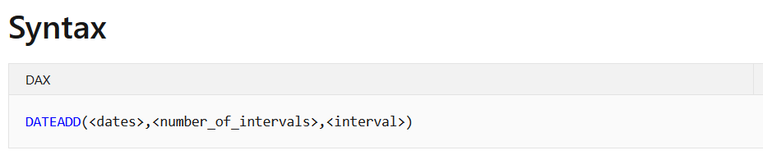
Time-intelligence functions in DAX
Example
DateAdd-1 = DATEADD(Orders[Order Date],-1,year)

Slide 61
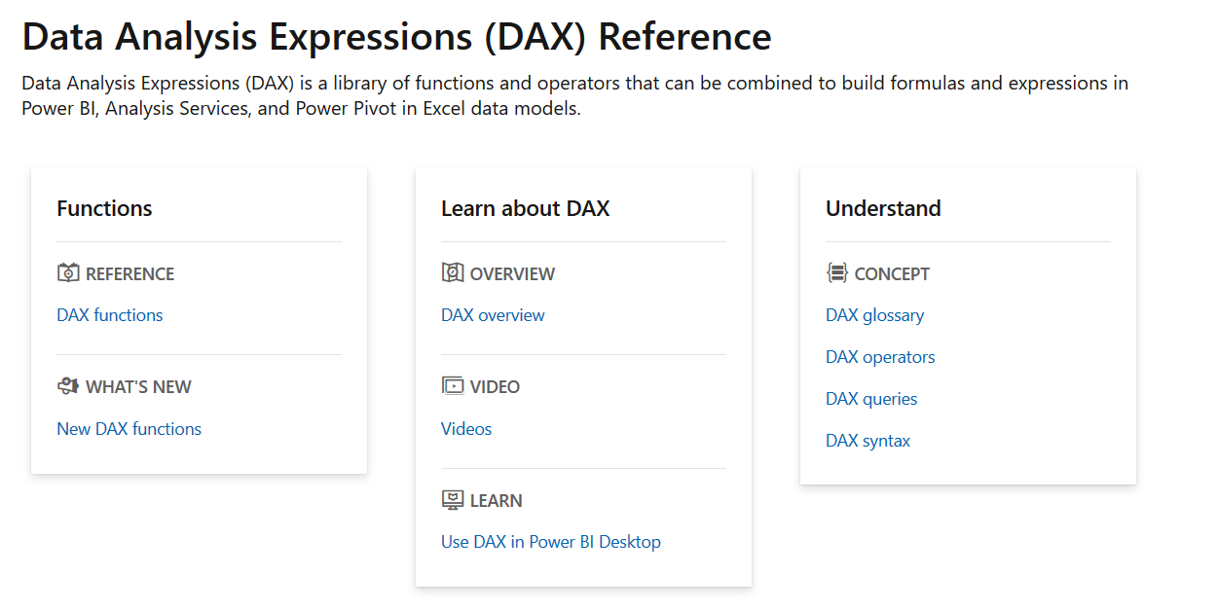
Learn More →
https://docs.microsoft.com/en-us/dax/

Slide 62
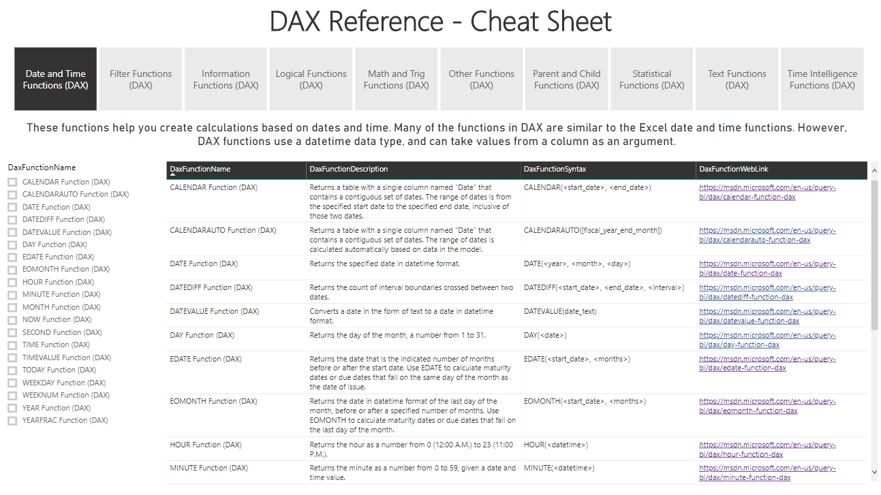

Slide 63
End Session II

